Slide 1

The EV Problem
By Stryder R. Coleman

Slide 2

Outline
What are Electric Vehicles
Reasons to purchase an EV
Slow Adaptation
Problems of EVS
What needs to be addressed?
The American Jobs Plan
Beyond the American Jobs Plan
Summary
Works Cited

Slide 3
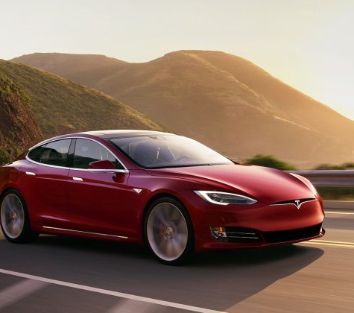
What is an electric vehicle ?
A vehicle that is powered by electricity instead of gas.
Electric Vehicles (EVs) have been around since the 1832 and more common in the 1870s

Slide 4

What drives people to purchase an EV?
To be more environmentally friendly
Electric is less expensive
Social Pressures
Less maintenance required
No Gas Station Stops
Notes:
EV lanes
Evs are better for the owners health

Slide 5
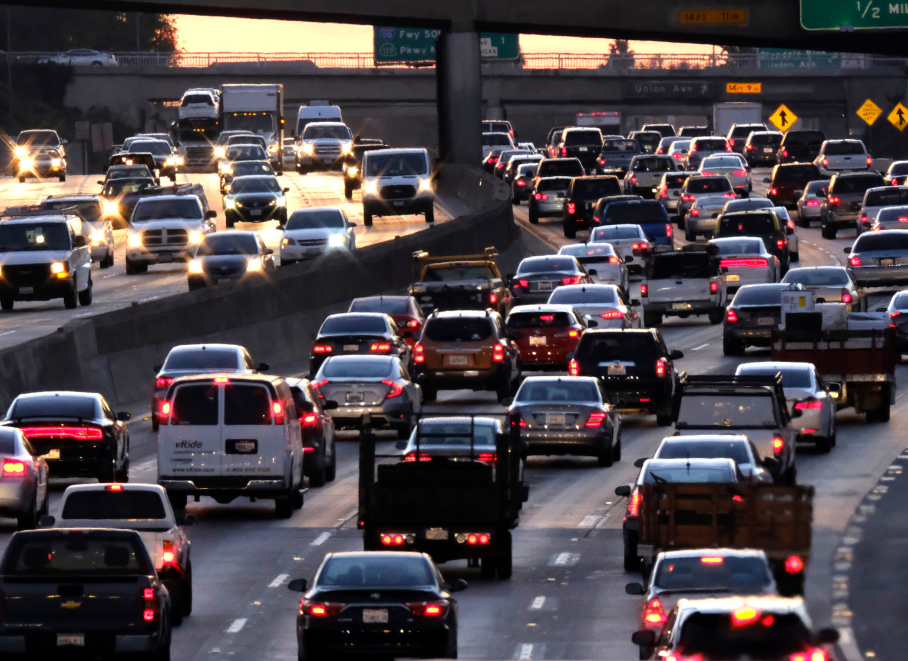
Slow adaption
However, adaptation is slow with very few people adapting the new technology
Many people underestimate the safety of EVS

Slide 6
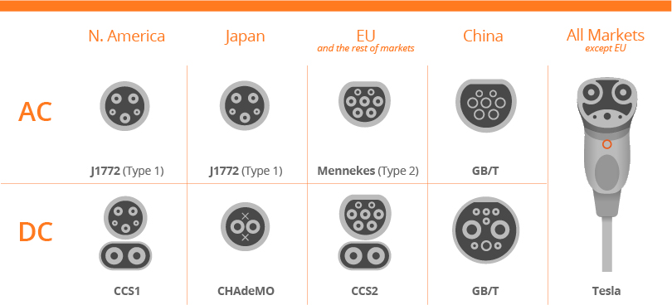
The problem with EVs
High initial cost
Small battery ranges
Charging Stations are rare
No standardized ports
Lobbying
Congress has lack of Understanding

Slide 7
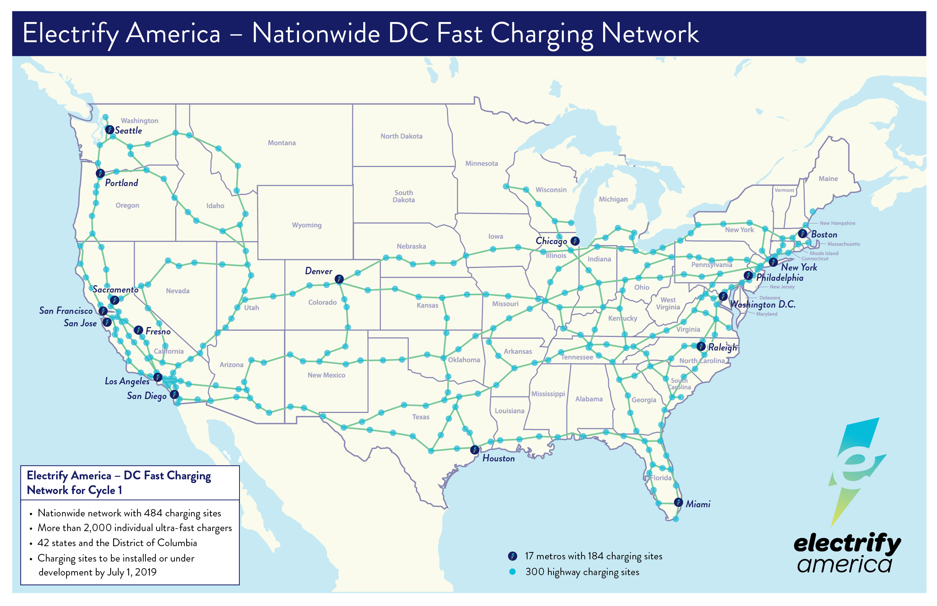
No charge zones
Large stretches of land where electric vehicles have no place to charge
Disproportionately in rural areas

Slide 8
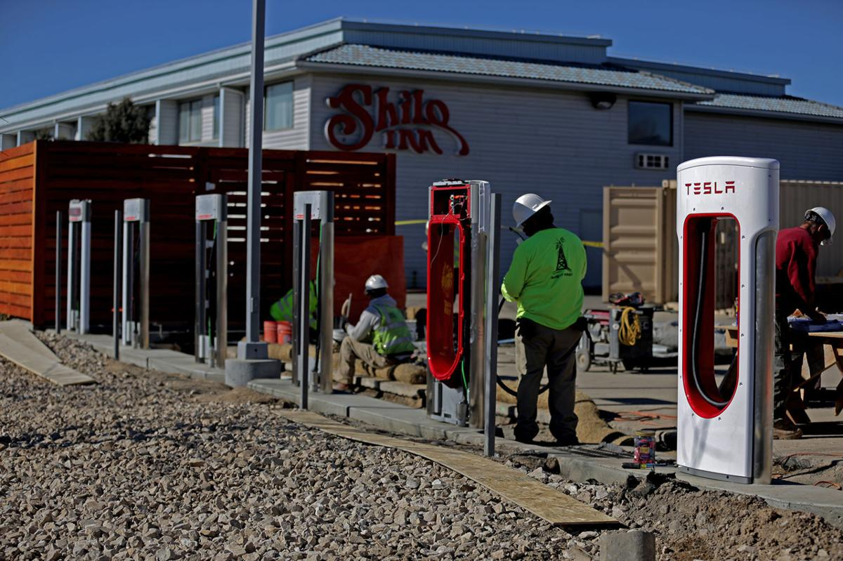
How can they be Addressed?
Tax Credits
Incentivizing construction in rural areas
Standardization
Electing more politicians with engineering backgrounds
The crumbling infrastructure

Slide 9
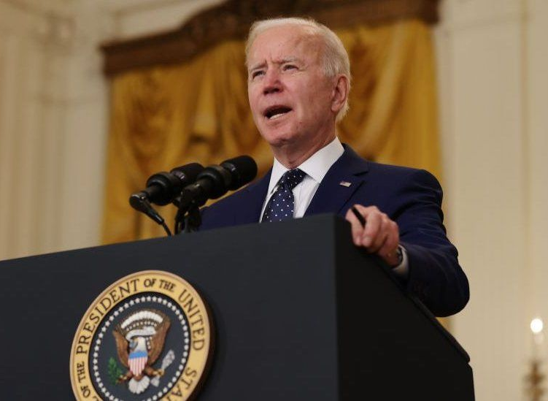
The American Jobs Plan
Tax credits
Research funding
Retooling Factories
Reevaluating supply chains
Training

Slide 10
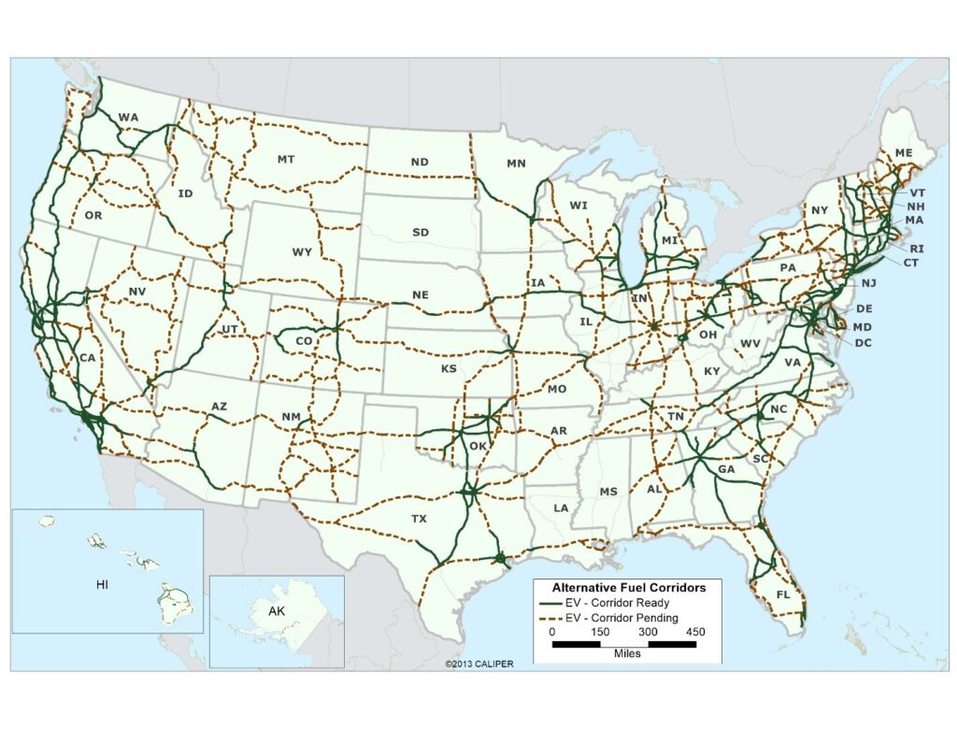
The American Jobs Plan Continued
Constructing 500,000 new charging stations
Installation standards
Renewable energy construction

Slide 11

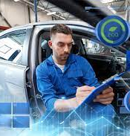

Beyond the American Jobs Plan
Train mechanics to operate on electric vehicles
Restrictions on lobbying
A plan for more charging stations

Slide 12

Summary
Electric cars are the future and will continue to grow in market size
More charging stations will be constructed with the standard J-plug
The American Jobs Plan will build/repair infrastructure
Continuation of tax credits

Slide 13
Works Cited
“How Many Gas Stations Are In U.S.? How Many Will There Be In 10 Years?” MarketWatch, MarketWatch, 16 Feb. 2020, www.marketwatch.com/story/how-many-gas-stations-are-in-us-how-many-will-there-be-in-10-years-2020-02-16#:~:text=There%20are%20about%20115%2C000%20gas,over%20the%20last%20two%20decades.
EVAdoption (e.d). (n.d.). EV charging STATIONS STATISTICS. Retrieved April 29, 2021, from https://evadoption.com/ev-charging-stations-statistics/#:~:text=With%20a%2045.0%25%20market%20share,and%20Blink%20Network%20(7.4%25).
Miles, Andy. “Standardization Of EV Charging In The EU.” CleanTechnica, 13 Sept. 2020, cleantechnica.com/2019/02/16/standardization-of-ev-charging-in-the-eu/.
Lozanova, S. (2021, March 04). 6 issues Facing electric vehicles. Retrieved April 28, 2021, from https://earth911.com/eco-tech/6-issues-with-electric-vehicles/
US Department of Energy. Maintenance and safety of hybrid and plug-in electric vehicles. (n.d.). Retrieved April 28, 2021, from https://afdc.energy.gov/vehicles/electric_maintenance.html#:~:text=EVs%20typically%20require%20less%20maintenance,reduced%20due%20to%20regenerative%20braking
White House. FACT sheet: The American jobs plan. (2021, April 08). Retrieved April 25, 2021, from https://www.whitehouse.gov/briefing-room/statements-releases/2021/03/31/fact-sheet-the-american-jobs-plan/

